Slide 1
SMART bIN
UI DESIGN

Slide 2
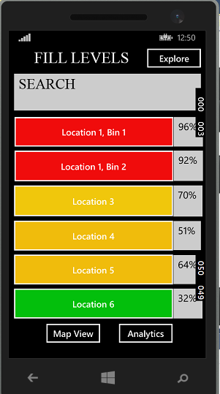
Home screen

Slide 3
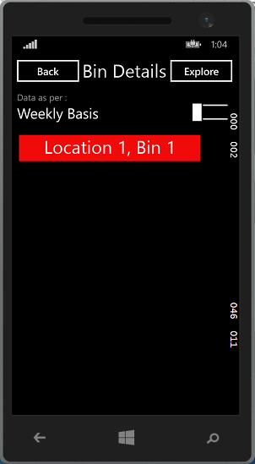
On tapping on location 1, bin 1 or any of the bins

Slide 4
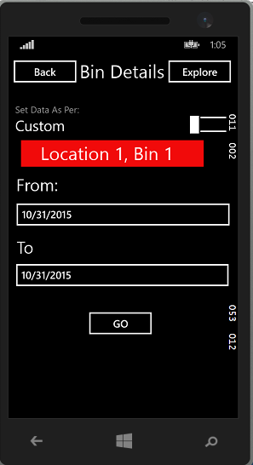
On toggling from weekly to custom through toggle switch

Slide 5
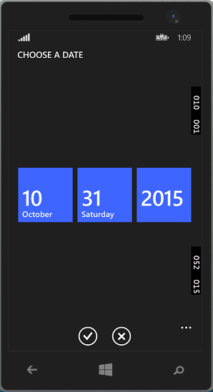
Select the date for the “from” and “to” categories by tapping on date

Slide 6
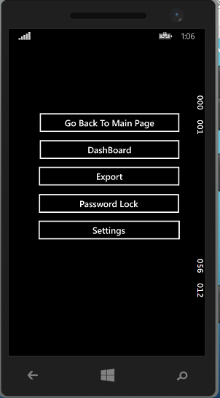
Tapping explore on right top corner

Slide 7
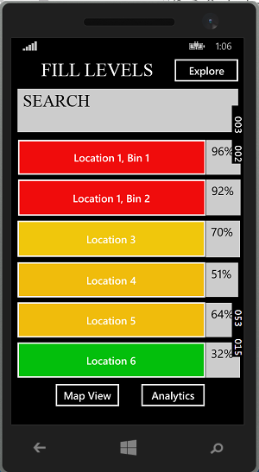
Tapping dashboard in the explore menu

Slide 8
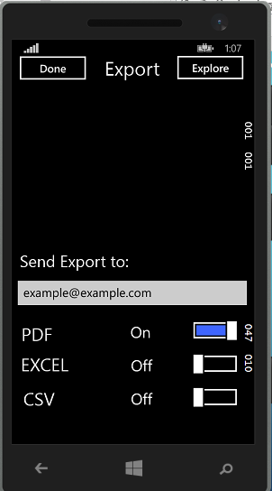
Tapping export in the explore menu

Slide 9
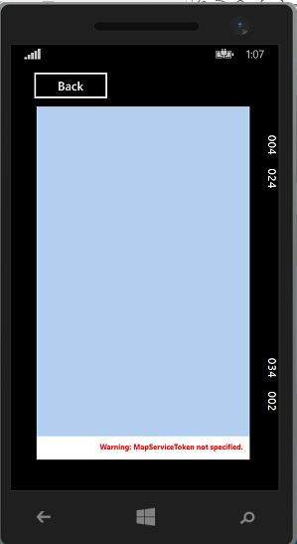
Tapping map view in the bottom let of main page

Slide 10
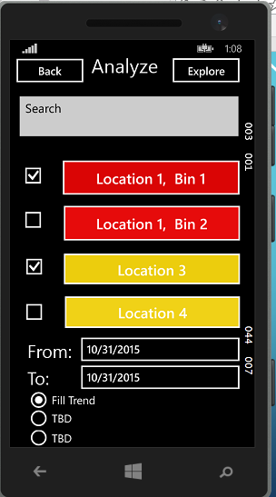
Tapping analytics in the bottom right of main page

